Slide 1
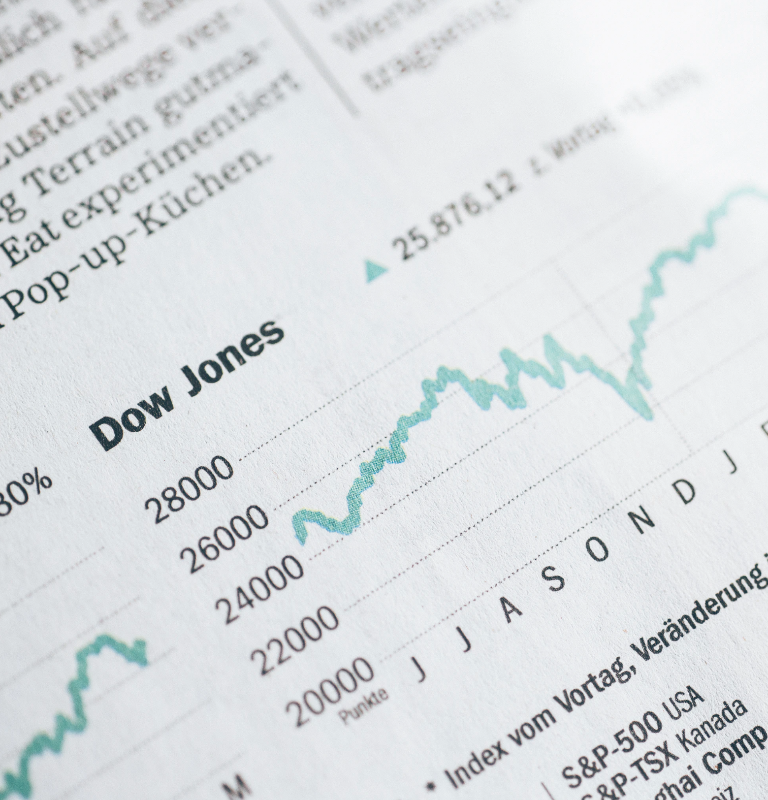
Fantasy Stock
PRESENTATION
Team Members
Nikki Sharma & Athena Liao
DATA MINING & MACHINE LEARNING
SPRING 1 2020
ST. THOMAS UNIVERSITY

Slide 2

Function Description
This function facilitates the buy/sell of stocks as per the following rules:
1. You are limited to 2 calls per minute, maximum 300 API calls per day.
2. You must make at least 250 successful trades (buy/sell) per day.
3. All trading is to be done between 10am-4pm.
Input
n : Number of API calls to do. (Maximum allowed is 300)
st_ex : List of stock symbols
Output
This will check through all the conditions mentioned and buy/sell stocks alternatively for the list of stock symbols.

Slide 3

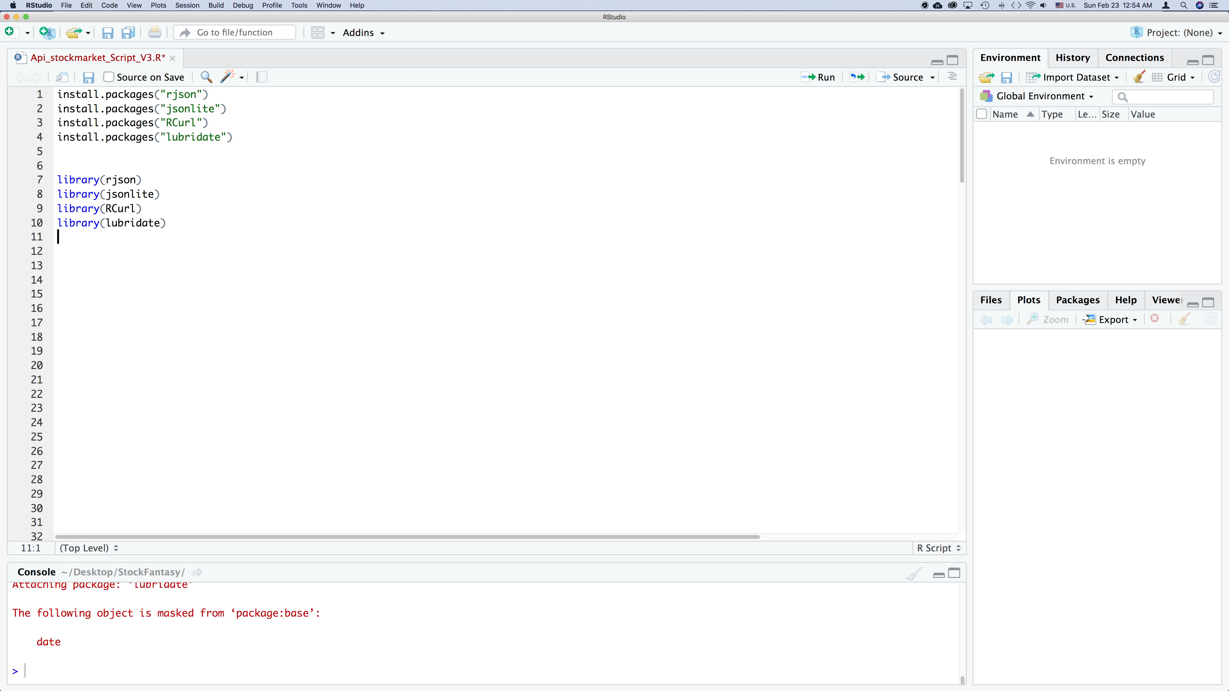
the Packages used in the script
rjson
jsonlite
rCurl
lubridate

Slide 4
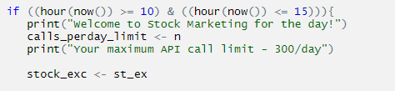
RULE 1: All trading is to be done between 10am-4pm.
n : Number of API calls to do. (Maximum allowed is 300)

Slide 5
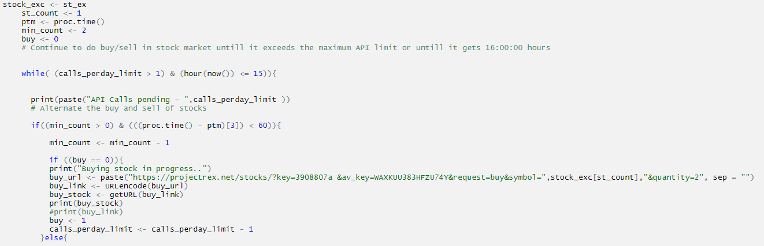
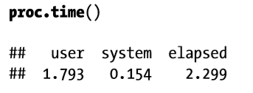
RULE 2: You must make at least 250 successful trades (buy/sell) per day
RULE 3: You are limited to 2 calls per minute, maximum 300 API calls per day.
st_ex : List of stock symbols
represents the actual time in
seconds elapsed between assigning and differencing proc.time()

Slide 6
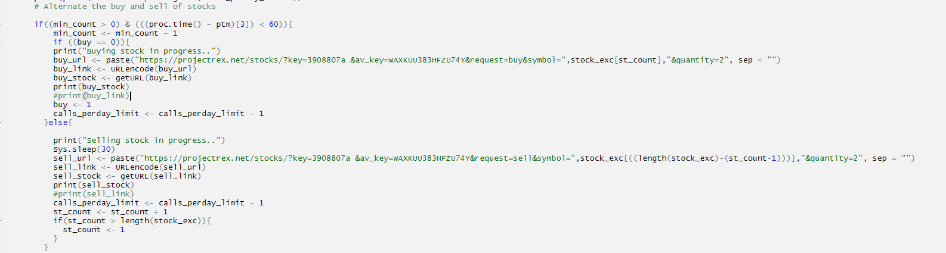
This function facilitates the buy/sell of stocks as per the following rules:
At least 250 successful trades (buy/sell) per day.

Slide 7
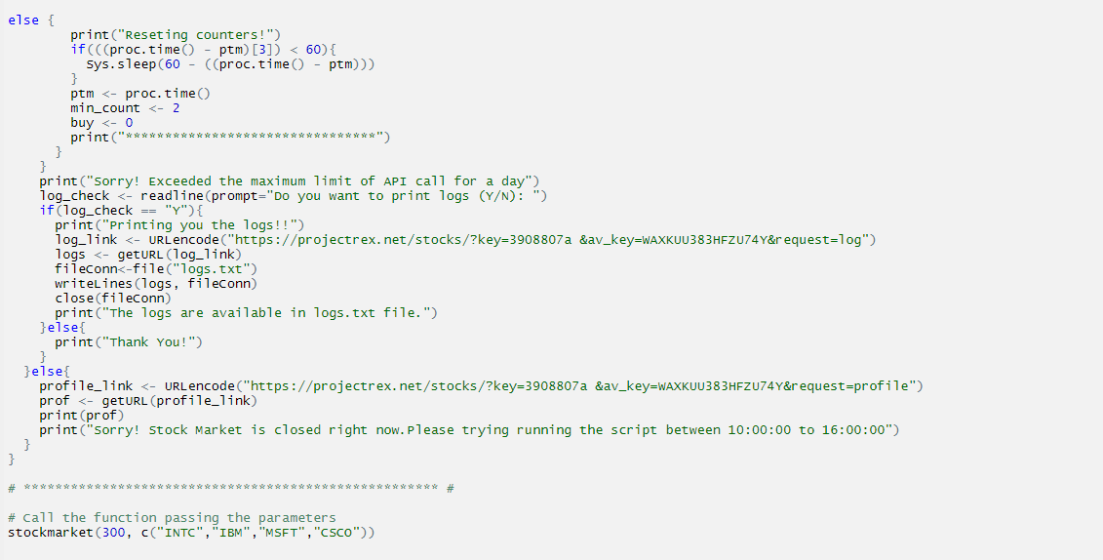
Else loop if exceeds maximum limit of API calls

Slide 8
THANK YOU

